Slide 1
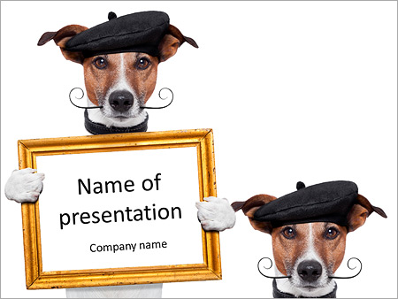

TrustEd Schools proudly present…

Slide 2

Art Gallery

Slide 3
Art Gallery
Would like to demonstrate your artistic skills in our Trust Art Gallery?
Winning teams from all Key Stages will be invited to an exhibition on Friday 13th February, hosted by St Leonard’s School!

Slide 4

The Rules!!!

Slide 5

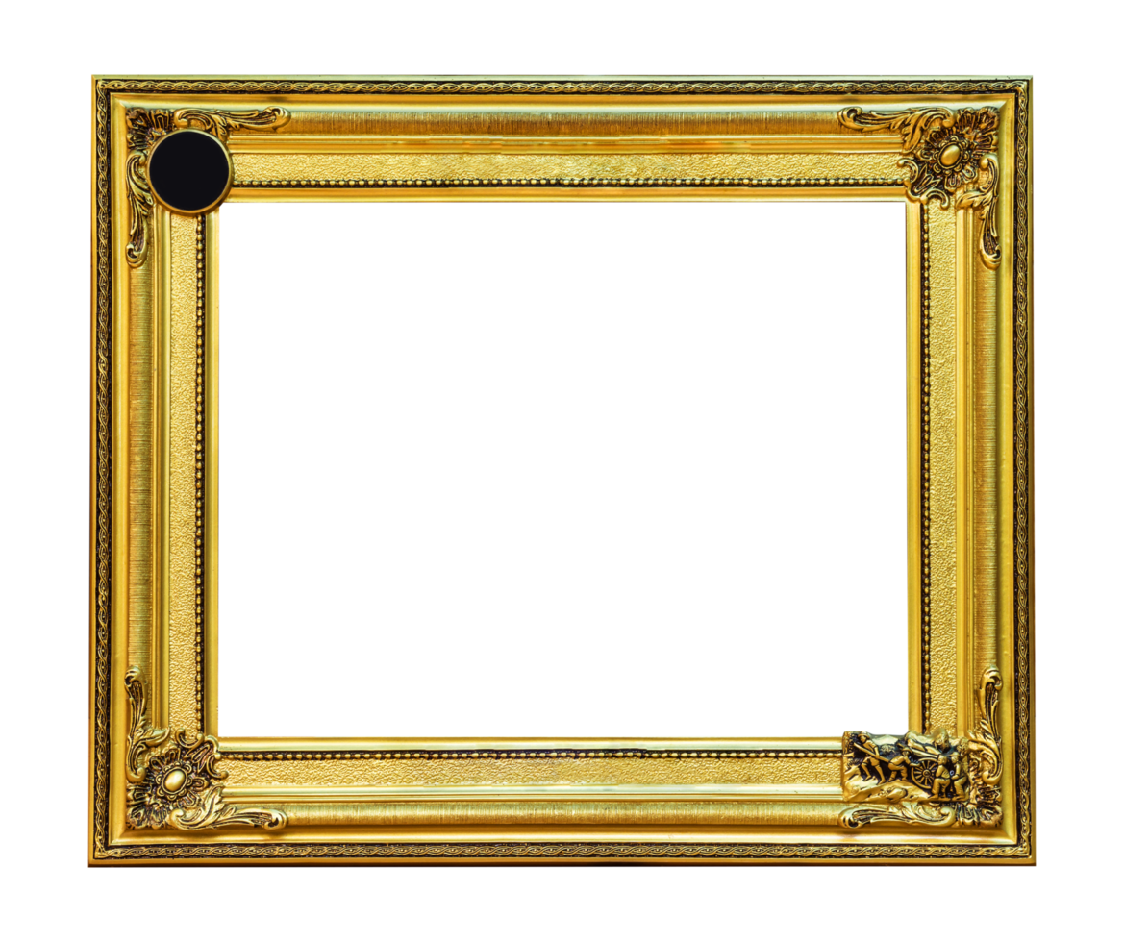
1
The competition is open to all children of all skill levels from EYFS to KS4.
All submissions must be original work, no copies or plagiarised art.

Slide 6
2
The theme is:
‘Turning Waste into Wonder’,
This supports the TrustEd Schools Council’s drive on being eco-friendly. The submitted artwork must reflect this theme.

Slide 7
3
Artists may use any 2D or 3D artform (e.g. painting, digital art, sculpture). This could include a combination of the above mediums.
Artists may also use recycled materials in their art.

Slide 8
4
The closing date for entries
to be emailed to Mrs Beagrie at St Leonard’s School is:
Thursday 29th January

Slide 9
5
Artwork will be displayed at a gallery morning at St Leonard’s Primary on Friday 13th Feb 2026.

Slide 10
6
There will be one winner from each of the 5 age groups (EYFS, KS1, 2, 3, 4)
The winning design(s) will be displayed in Bridgnorth. (Town hall/shops)

Slide 11
7
As a condition of entry, pupils agree to grant the TrustEd Schools license to reproduce the design on our website.

Slide 12
8
We really look forward to seeing what you can produce!!!

Slide 13
9
For more information – see
XXXXXXXXX

